Slide 1

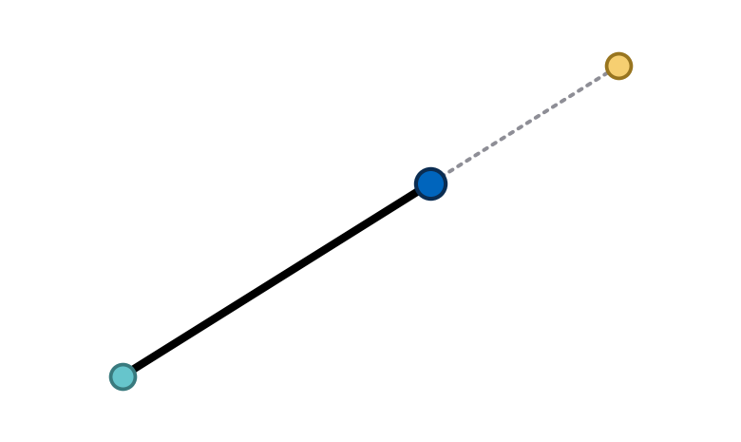
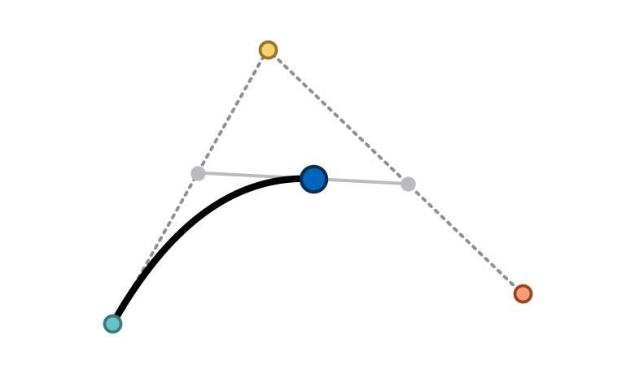
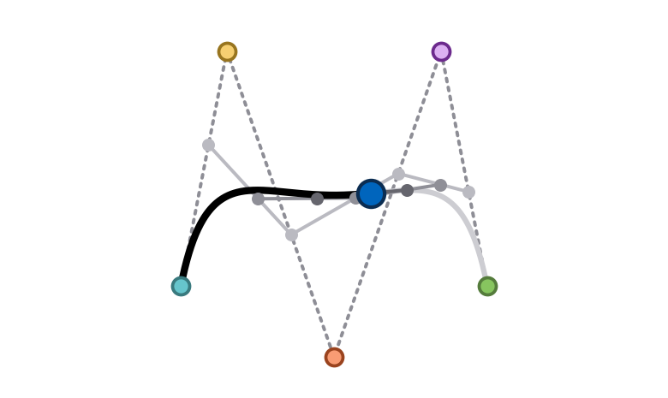
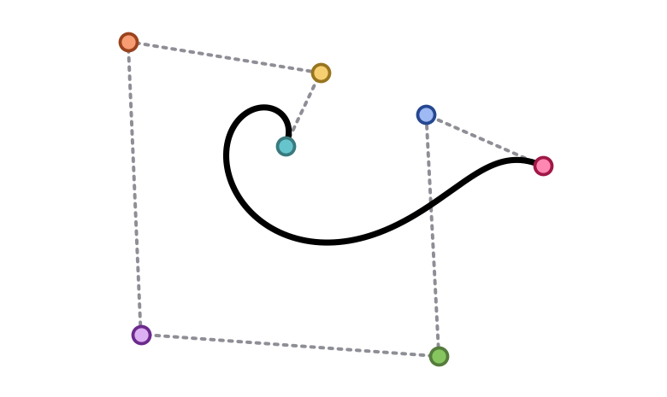
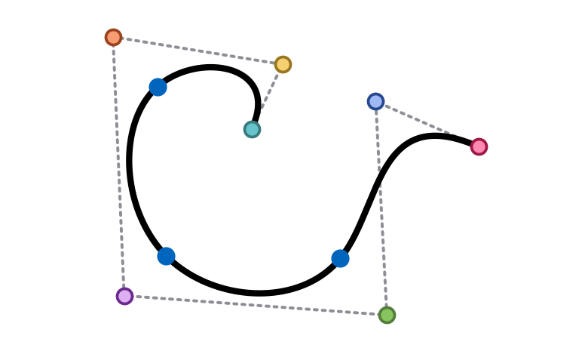
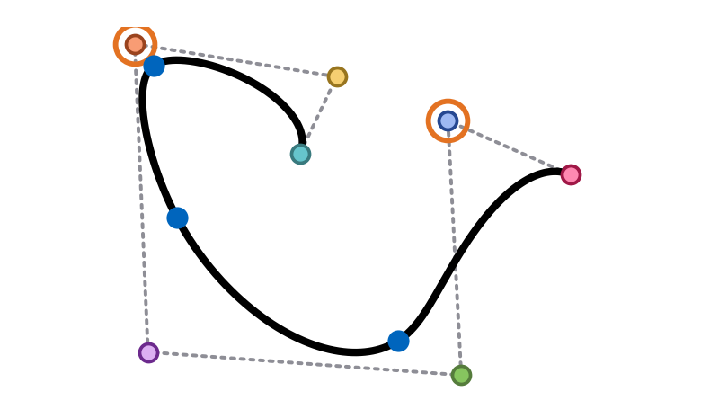
From Bézier to NURBS
COMPUTATIONAL DESIGN AND FABRICATION I (WISE 2026/27)
Computational Geometry | Freeform curves
Notes:
Freeform curves step by step: from Bézier curves to B-splines, non-uniform B-splines and NURBS.

Slide 2
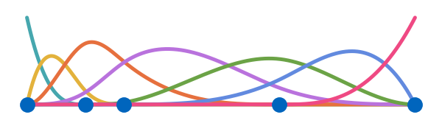
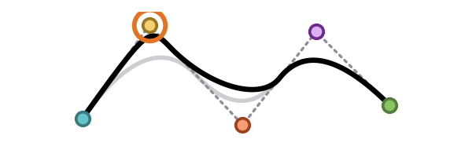
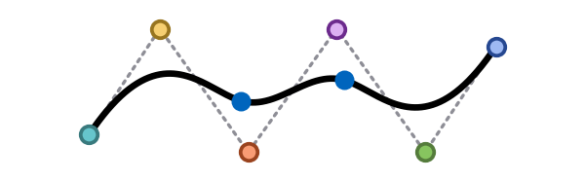
What is NURBS?
FREEFORM CURVES > INTRODUCTION
Non-Uniform
The knots, where the curve's pieces meet, can be spaced unevenly.
Rational
Every control point has a weight that pulls the curve in or lets it go.
B-Spline
Basis spline: a smooth curve made of polynomial pieces joined at knots.
Bézier curve
B-spline
Non-uniform B-spline
NURBS
control points
›
control points
›
control points
›
control points
knots
uneven knots
uneven knots
weights
WE BUILD IT UP STEP BY STEP
Notes:
NURBS stands for Non-Uniform Rational B-Spline. We read the name backwards: we start from Bézier curves, then B-splines, then uneven (non-uniform) knots, then weights (rational). Each step adds one ingredient. Rhino and most CAD tools use NURBS as their main way to describe curves and surfaces.

Slide 3
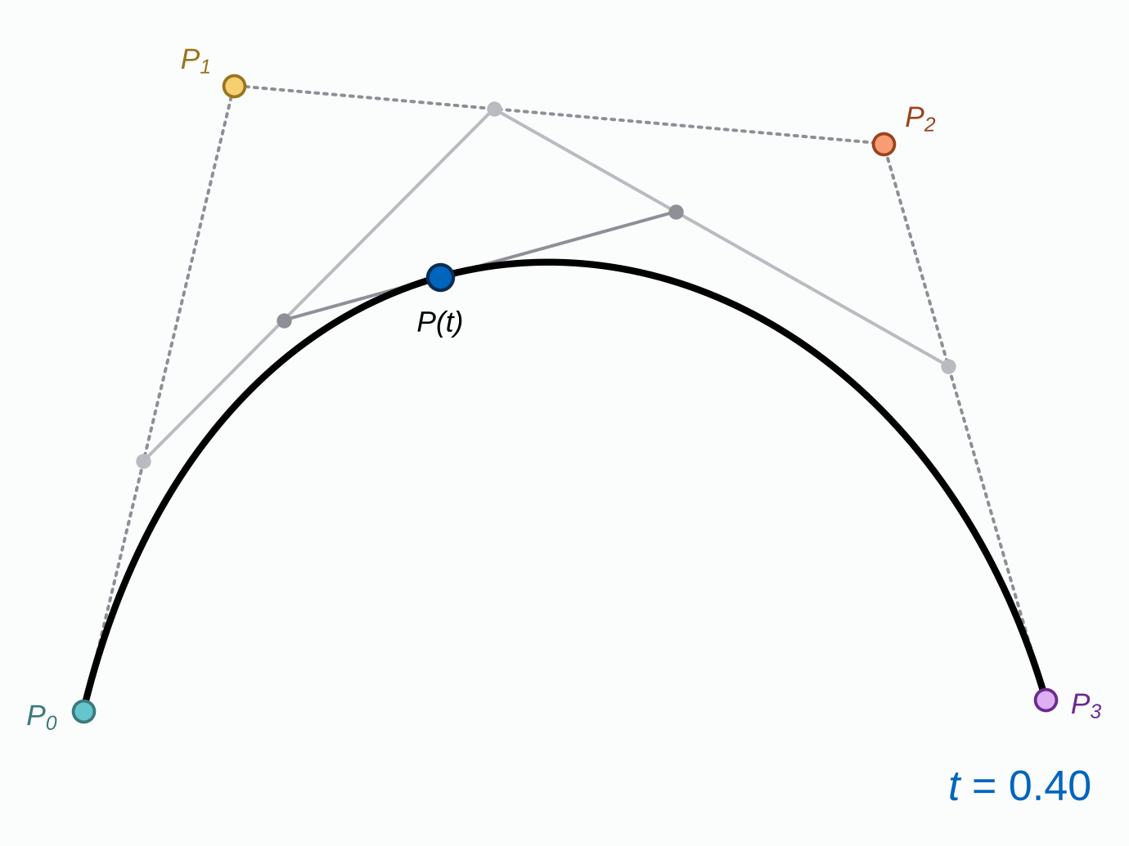
Bézier Curves
FREEFORM CURVES > 1. BÉZIER CURVES
Named after Pierre Bézier, an engineer at Renault, who used them in the 1960s to design car bodies.
Paul de Casteljau found the same curves at Citroën in 1959. We follow his construction on the next slides.
DEFINITION
A Bézier curve is built by repeated linear interpolation between its control points.
Linear interpolation: the point a fraction t of the way along a straight segment, 0 ≤ t ≤ 1.
Notes:
Pierre Bézier (Renault) published the method in the 1960s and used it in Renault's UNISURF CAD system for car bodies. Paul de Casteljau developed the same curves at Citroën in 1959, but his work stayed internal for years. The picture already shows the whole idea: the grey points come from interpolating again and again, and the last (blue) point lies on the curve.

Slide 4
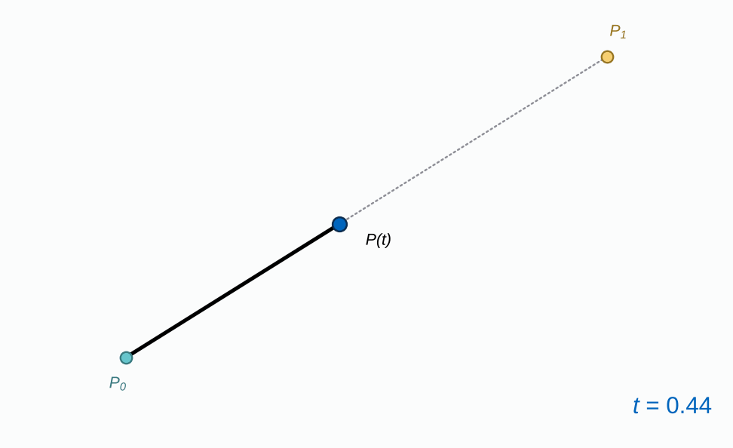
Consider a Line
FREEFORM CURVES > 1. BÉZIER CURVES
Start with two control points P₀ and P₁.
A parameter t runs from 0 to 1.
P(t) lies a fraction t of the way from P₀ to P₁:
t = 0 → P₀
t = 0.5 → the midpoint
t = 1 → P₁
This is linear interpolation.
Notes:
As t runs from 0 to 1, P(t) slides from P0 to P1 and traces the segment. A Bézier curve with two control points is exactly this straight line: degree 1.

Slide 5
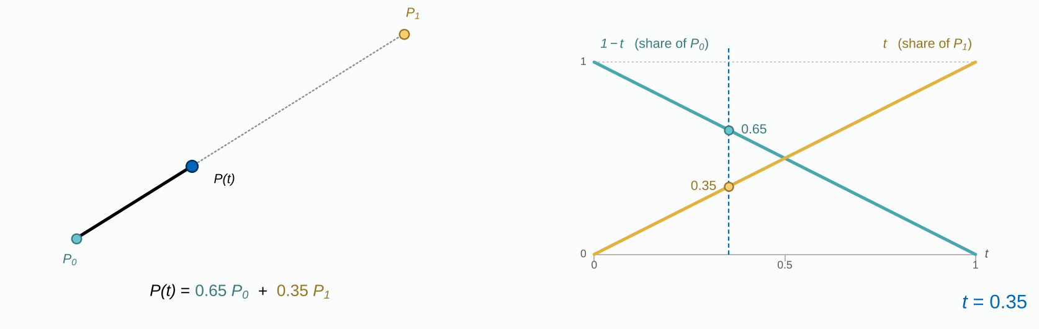
Consider a Line
FREEFORM CURVES > 1. BÉZIER CURVES
P(t) = (1 − t) · P₀ + t · P₁
Each control point gets a share of P(t).
The shares always add up to 1.
The curves that give the shares are the basis functions.
Notes:
Read the plot as: how much does each control point count at this t? At t = 0 only P0 counts, at t = 1 only P1. These share curves, the basis functions, come back on every slide: they explain later why Bézier curves have no local control and B-splines do.

Slide 6
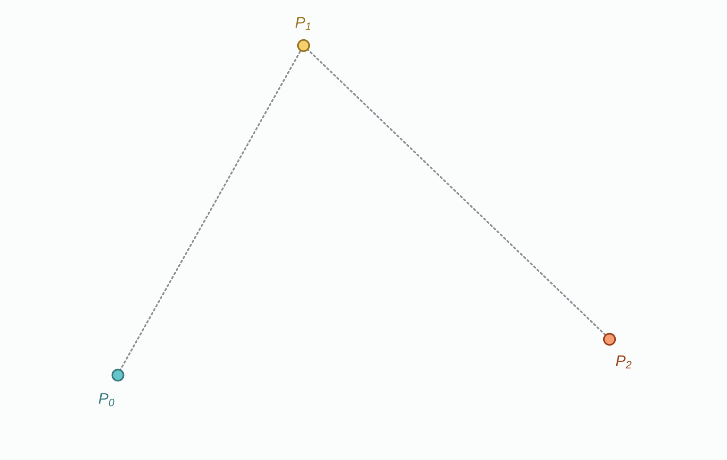
Extending to 3 Control Points
FREEFORM CURVES > 1. BÉZIER CURVES
Add a third control point. We want a smooth curve from P₀ to P₂ that is pulled towards P₁.
Idea: use the line trick more than once.
Notes:
Three control points. The curve should start at P0, end at P2, and only be attracted by P1 (it will not pass through it).

Slide 7
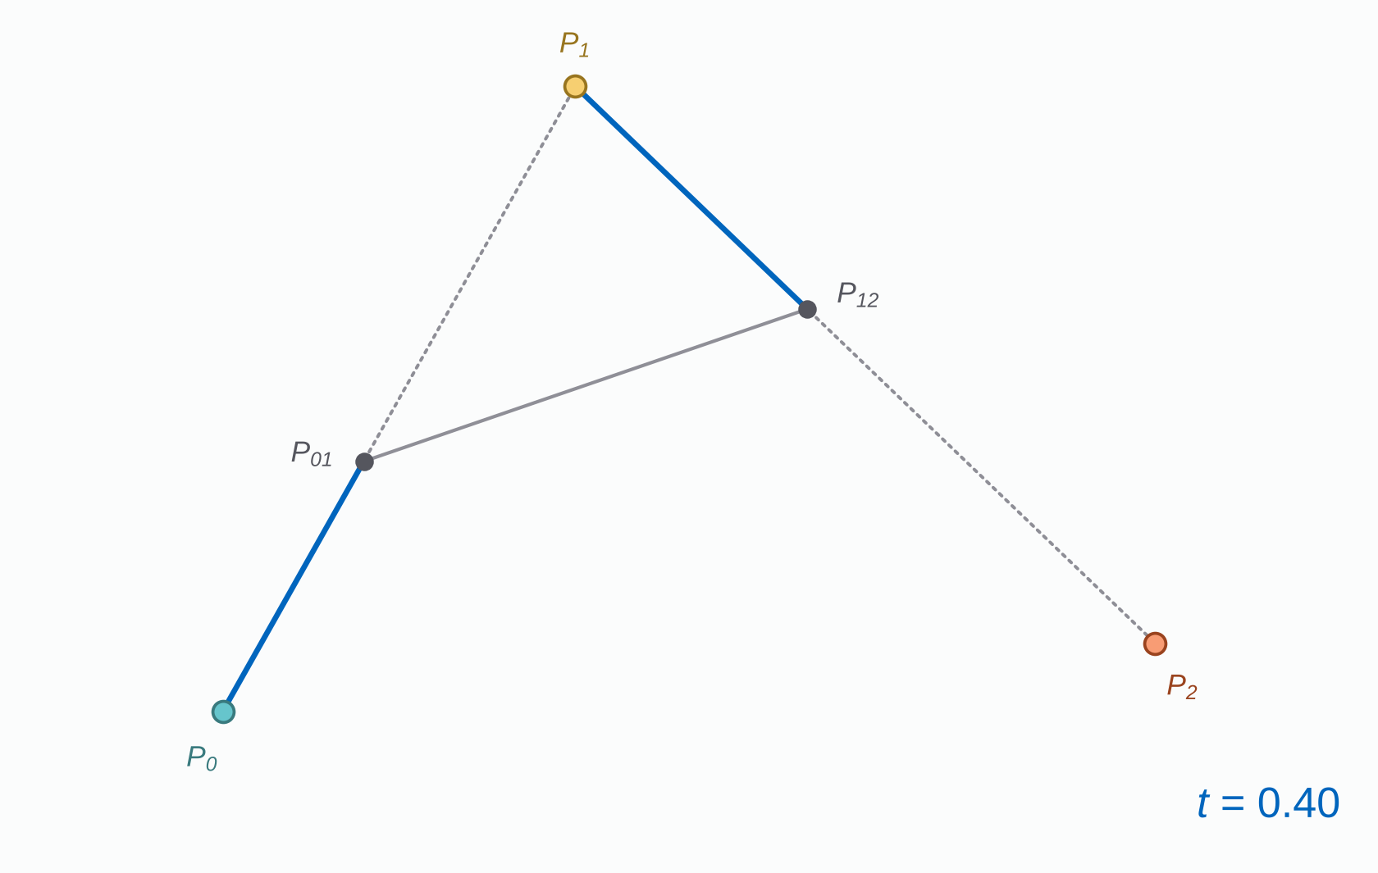
Extending to 3 Control Points
FREEFORM CURVES > 1. BÉZIER CURVES
Add a third control point. We want a smooth curve from P₀ to P₂ that is pulled towards P₁.
Idea: use the line trick more than once.
1. On each leg, interpolate with the same t: P₀₁ on P₀–P₁ and P₁₂ on P₁–P₂.
Notes:
Step 1: the same t on both legs. At t = 0.4 both blue segments are 40% of their leg.

Slide 8
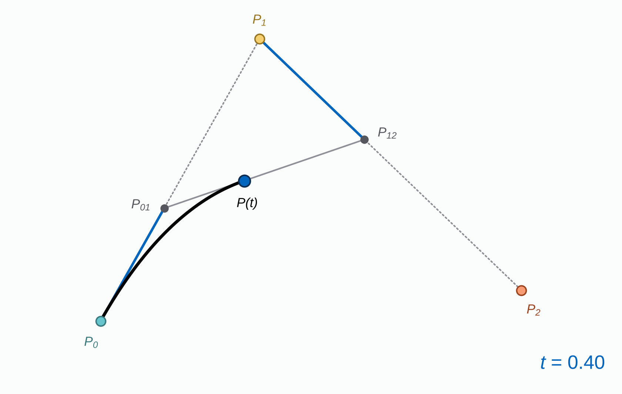
Extending to 3 Control Points
FREEFORM CURVES > 1. BÉZIER CURVES
Add a third control point. We want a smooth curve from P₀ to P₂ that is pulled towards P₁.
Idea: use the line trick more than once.
1. On each leg, interpolate with the same t: P₀₁ on P₀–P₁ and P₁₂ on P₁–P₂.
2. Interpolate between P₀₁ and P₁₂ with the same t. The result P(t) lies on the curve.
Notes:
Step 2: one more interpolation between the two new points. P(t) is a point of the curve; the black part shows everything traced so far.

Slide 9
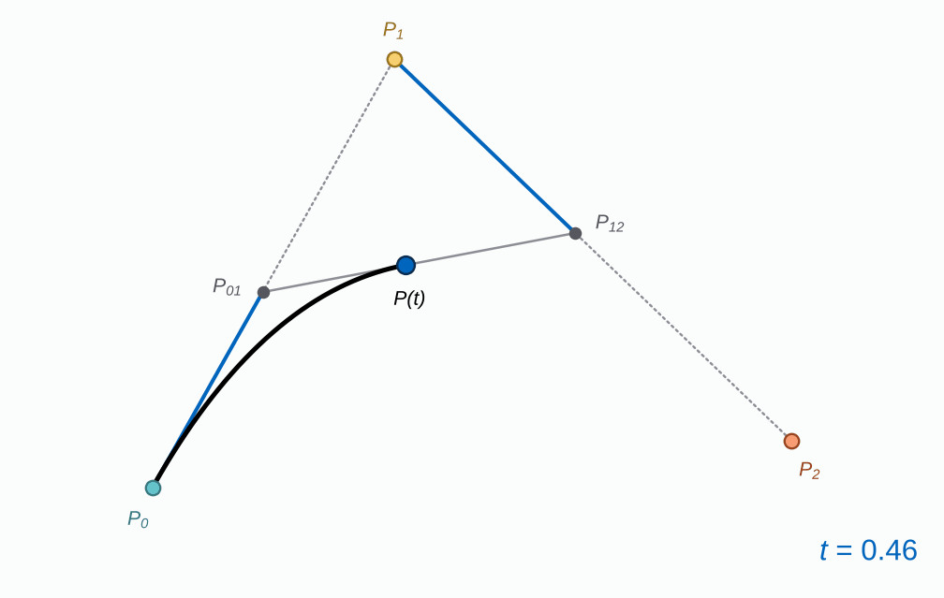
Extending to 3 Control Points
FREEFORM CURVES > 1. BÉZIER CURVES
Add a third control point. We want a smooth curve from P₀ to P₂ that is pulled towards P₁.
Idea: use the line trick more than once.
1. On each leg, interpolate with the same t: P₀₁ on P₀–P₁ and P₁₂ on P₁–P₂.
2. Interpolate between P₀₁ and P₁₂ with the same t. The result P(t) lies on the curve.
3. Repeat for every t from 0 to 1: P(t) traces the curve. This is de Casteljau's algorithm.
Notes:
Step 3: sweep t from 0 to 1. Repeated linear interpolation produces a smooth curve: this is de Casteljau's algorithm.

Slide 10
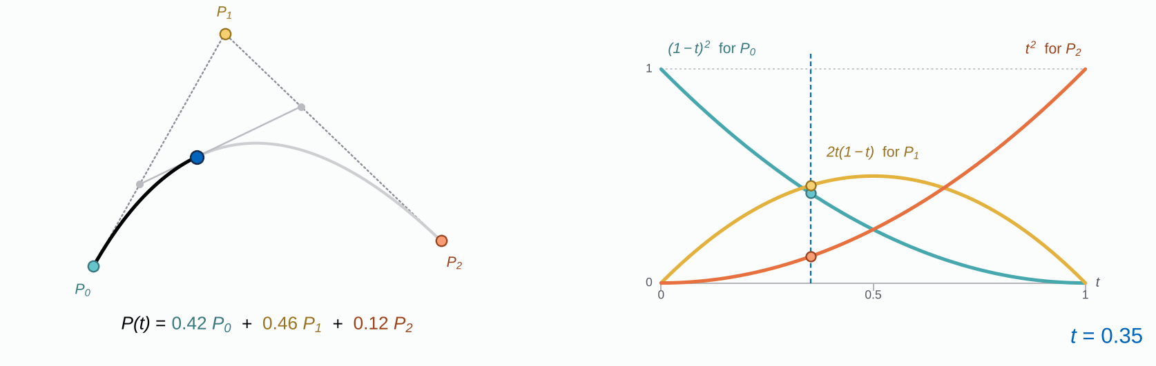
Extending to 3 Control Points
FREEFORM CURVES > 1. BÉZIER CURVES
P(t) = (1 − t)² · P₀ + 2t(1 − t) · P₁ + t² · P₂
3 control points → degree 2 (highest power of t)
degree = number of control points − 1
Notes:
Writing the two interpolation steps out gives three basis functions (Bernstein polynomials). They are never negative and add up to 1 for every t, so P(t) is always a weighted average of the control points. That is why the curve stays inside the control polygon.

Slide 11
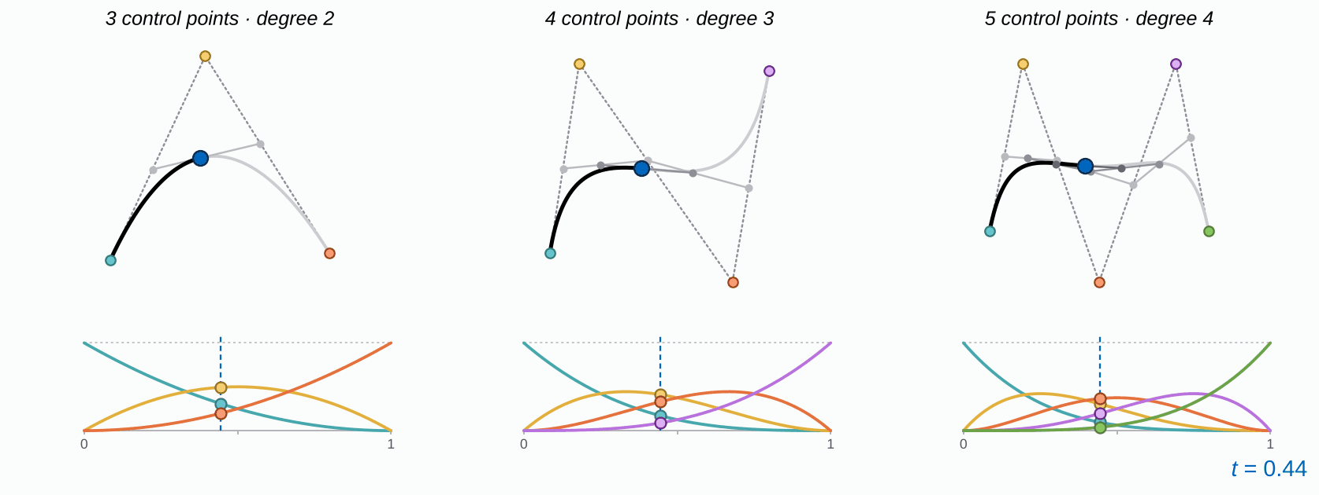
Extending to n Control Points
FREEFORM CURVES > 1. BÉZIER CURVES
Notes:
Every extra control point adds one more level of interpolation and raises the degree by one. Look at the plots: every basis function is above zero for the whole range of t. Keep that in mind for the next slide.

Slide 12
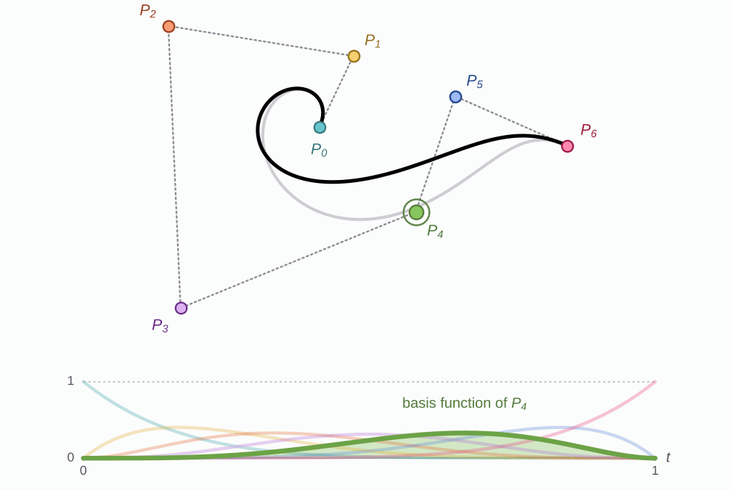
Limits of Bézier Curves
FREEFORM CURVES > 1. BÉZIER CURVES
7 control points → degree 6
– no local control: moving P₄ changes the whole curve
– passes only through the first and last control points
– many control points → high degree → slow to compute and hard to shape
Why? The basis function of P₄ (bottom) is non-zero for every t, so P₄ always has a share.
Notes:
This is the control polygon of the summary slide. One Bézier curve through 7 control points has degree 6. Dragging P4 moves the whole curve, including the spiral at the start, because its basis function is non-zero everywhere. Many points mean a high degree, which is slow to evaluate and hard to shape.

Slide 13
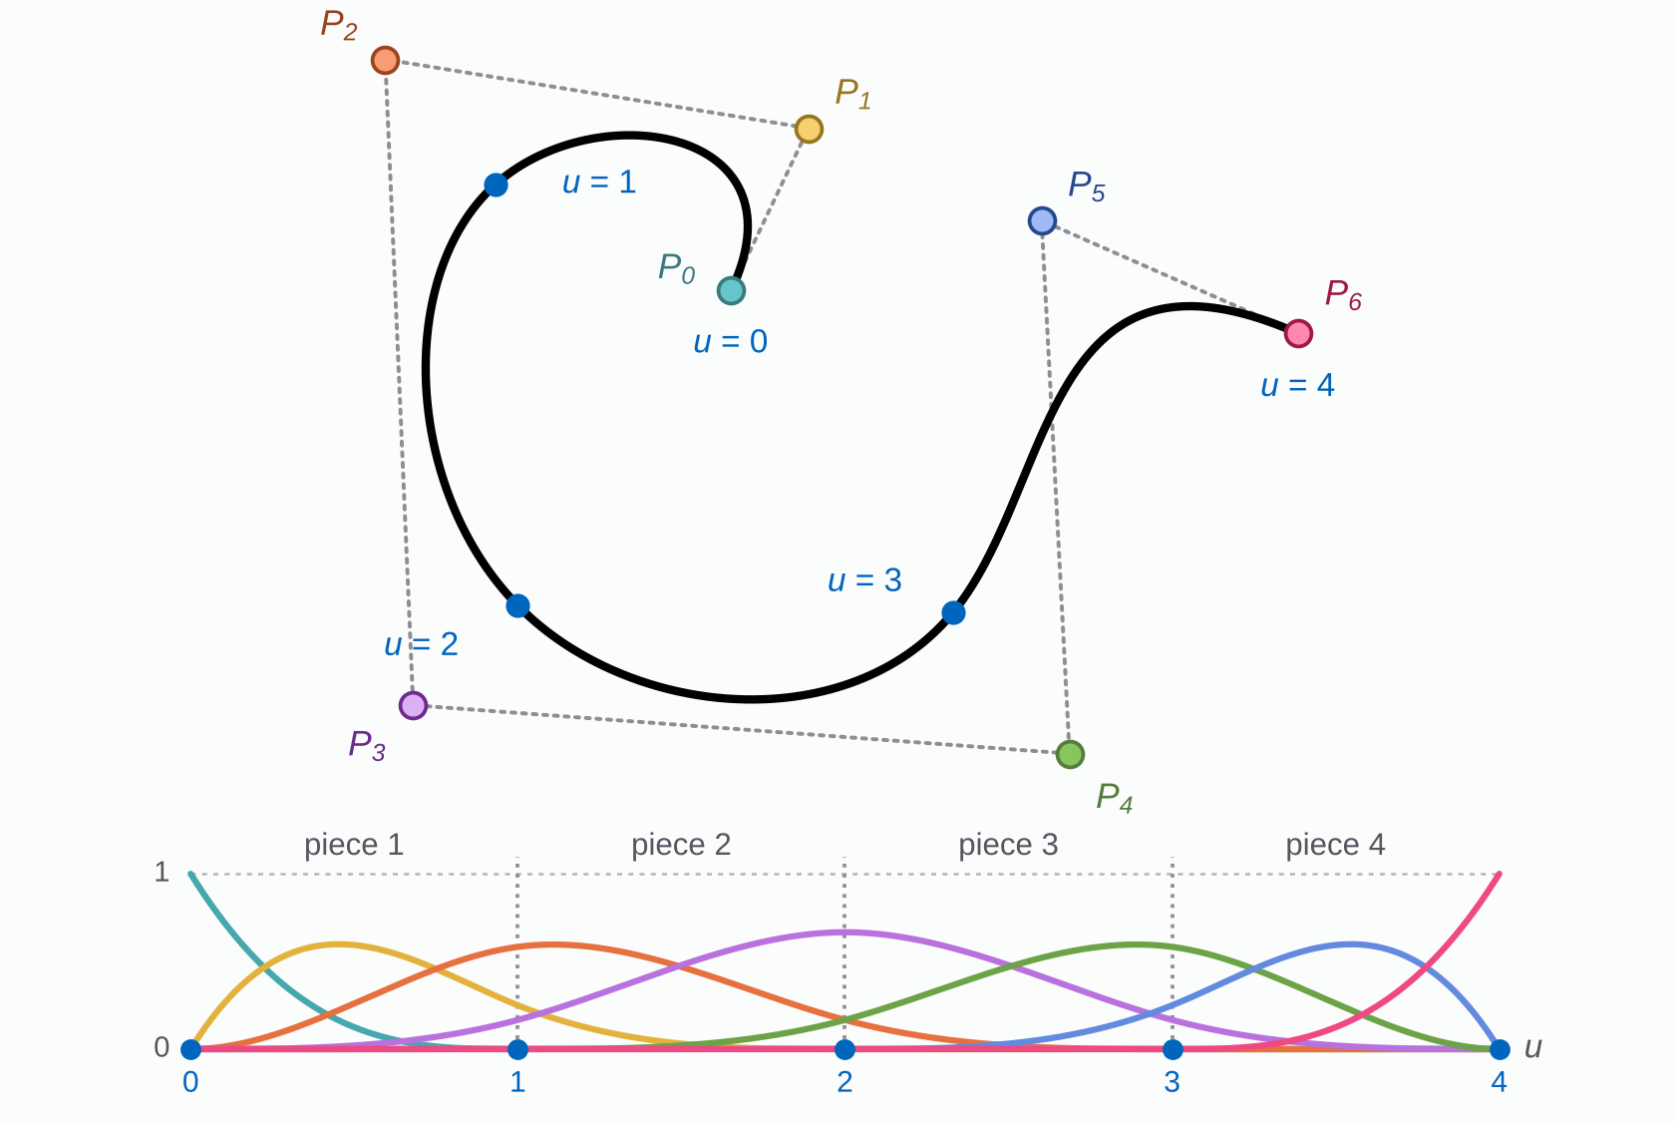
B-Splines
FREEFORM CURVES > 2. B-SPLINES
A B-spline is a chain of polynomial pieces, joined smoothly at knots.
Knot: a parameter value u where one piece ends and the next begins.
Here:
degree 3
7 control points → 4 pieces
knots at u = 0, 1, 2, 3, 4.
+ each basis function covers only a few pieces
→ local control
+ the degree stays low with many control points
Notes:
B stands for basis. The parameter is now called u and runs over the knot values, here 0 to 4. Four cubic pieces meet at the knots u = 1, 2, 3 with matching position, tangent and curvature. Each basis function spans at most degree + 1 = 4 pieces, so a control point only influences the pieces under its basis function.

Slide 14
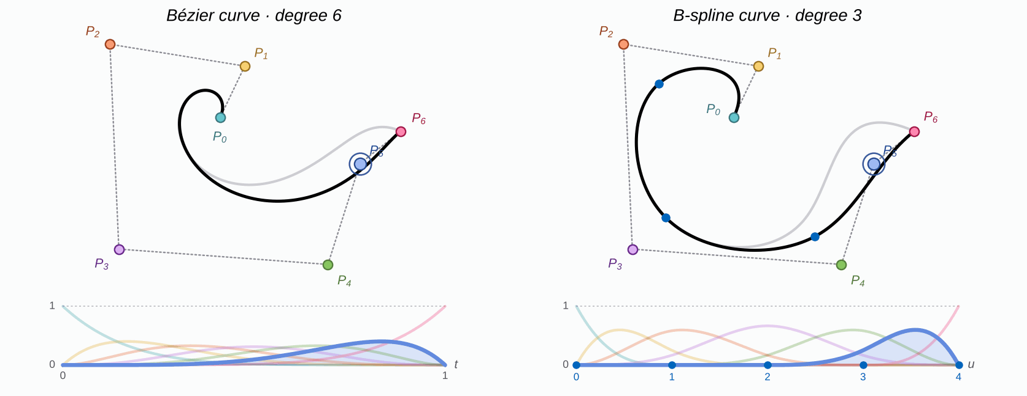
Bézier vs B-Spline
FREEFORM CURVES > 2. B-SPLINES
– moving P₅ changes the whole curve
+ moving P₅ only changes the curve for u between 2 and 4
Notes:
Same control polygon, same moved point P5. The highlighted basis function shows how far P5 reaches: for the Bézier curve it covers all of t, for the B-spline only the last two pieces (u from 2 to 4). The spiral at the start of the B-spline does not move at all: local control.

Slide 15
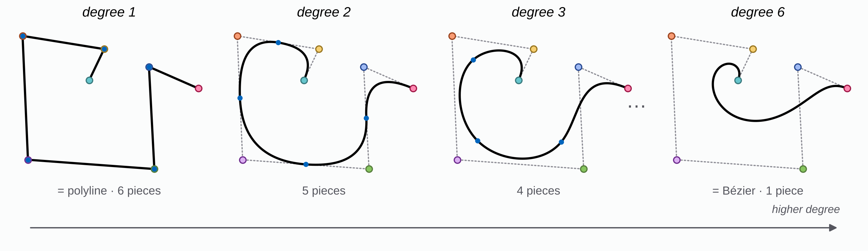
B-Spline Degree
FREEFORM CURVES > 2. B-SPLINES
Degree p: every piece is a polynomial of degree p:
1 gives straight segments, 2 parabolic arcs, 3 cubic pieces.
pieces = control points − degree
Higher degree → smoother curve, but each control point reaches further along it.
degree = control points − 1 gives back the Bézier curve.
degree = 1 gives a Polyline connecting the control points.
Notes:
Same 7 control points, same type of knot vector, only the degree changes. Degree 1 is the polyline itself; degree 6 (control points - 1) has a single piece and is exactly the Bézier curve. Degree 3 is the usual compromise and Rhino's default.

Slide 16
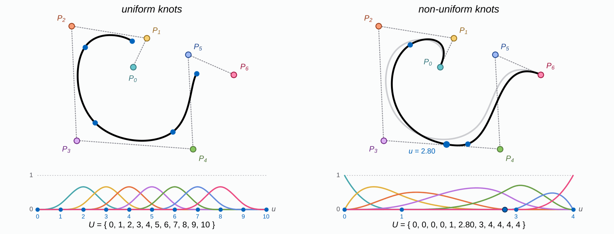
Non-Uniform B-Splines
FREEFORM CURVES > 3. NON-UNIFORM B-SPLINES
Uniform: equal knot spacing, all basis functions look the same. The curve does not reach P₀ or P₆.
Non-uniform: repeated end knots pin the curve to P₀ and P₆. Moving an inner knot changes where two pieces meet.
Notes:
The knot vector U lists all knot values. Uniform means equally spaced: every basis function has the same shape, and the curve stops short of P0 and P6. Repeating the end knots degree + 1 times makes the curve start and end exactly at P0 and P6. The B-splines on the previous slides were built this way, so strictly they were already non-uniform. In the animation the inner knot slides between 1.2 and 2.8 and the pieces are redistributed along the curve.

Slide 17
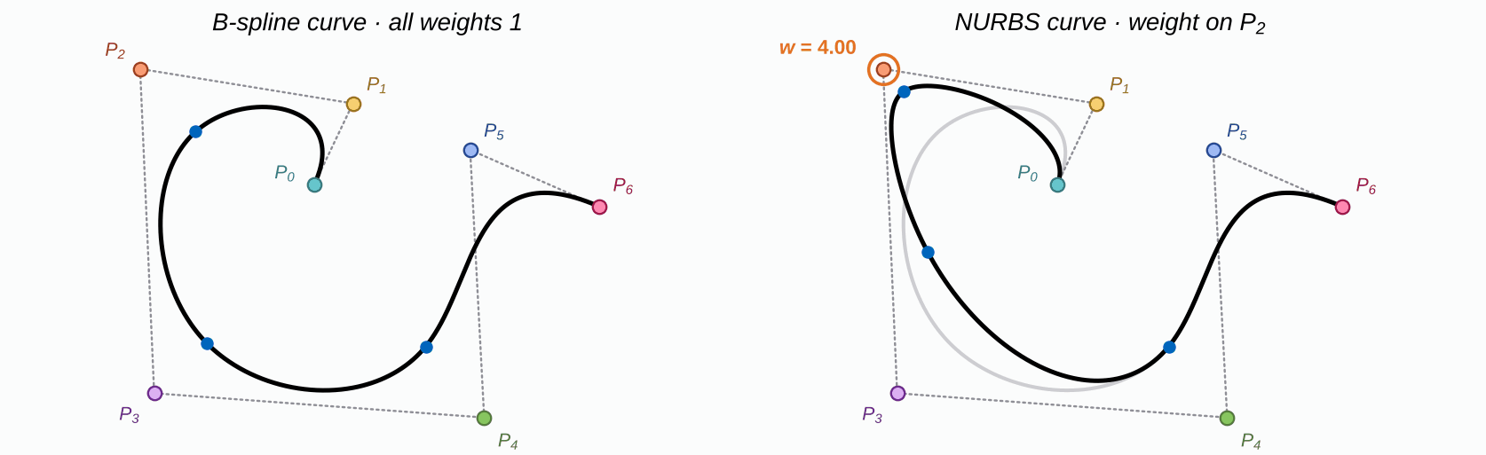
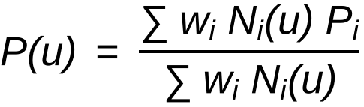
Non-Uniform Rational B-Splines (NURBS)
FREEFORM CURVES > 4. NURBS
+ a weight per control point:
w > 1 pulls the curve in, w < 1 lets it go
+ represents exact circles and other conic sections
(ellipse, parabola, hyperbola)
Rational: a ratio of two polynomials
w_{i}: weight · N_{i}: basis function
Notes:
Each control point gets a weight w. With all weights equal to 1 the fraction reduces to the ordinary B-spline, because the basis functions add up to 1. Raising the weight of P2 pulls the curve towards it; a weight below 1 lets it go. A single polynomial can never trace an exact circle; a fraction of two polynomials can. That is what the next slide shows.

Slide 18
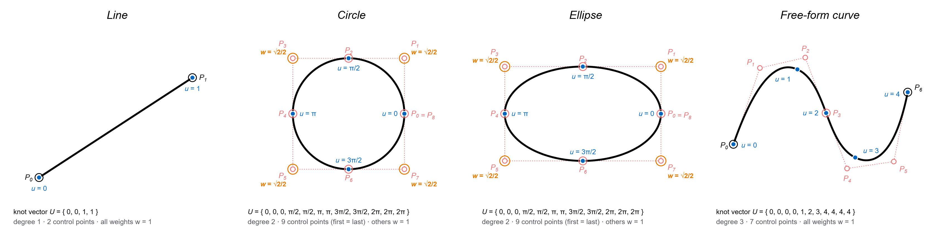
NURBS Curves
FREEFORM CURVES > 4. NURBS
Notes:
One data structure (control points, knots, weights) covers all of these. Line: degree 1, two control points. Circle and ellipse: degree 2, nine control points with the first equal to the last; the corner weights are √2/2 ≈ 0.707, all others 1. Free-form curve: a degree-3 B-spline, all weights 1.

Slide 19
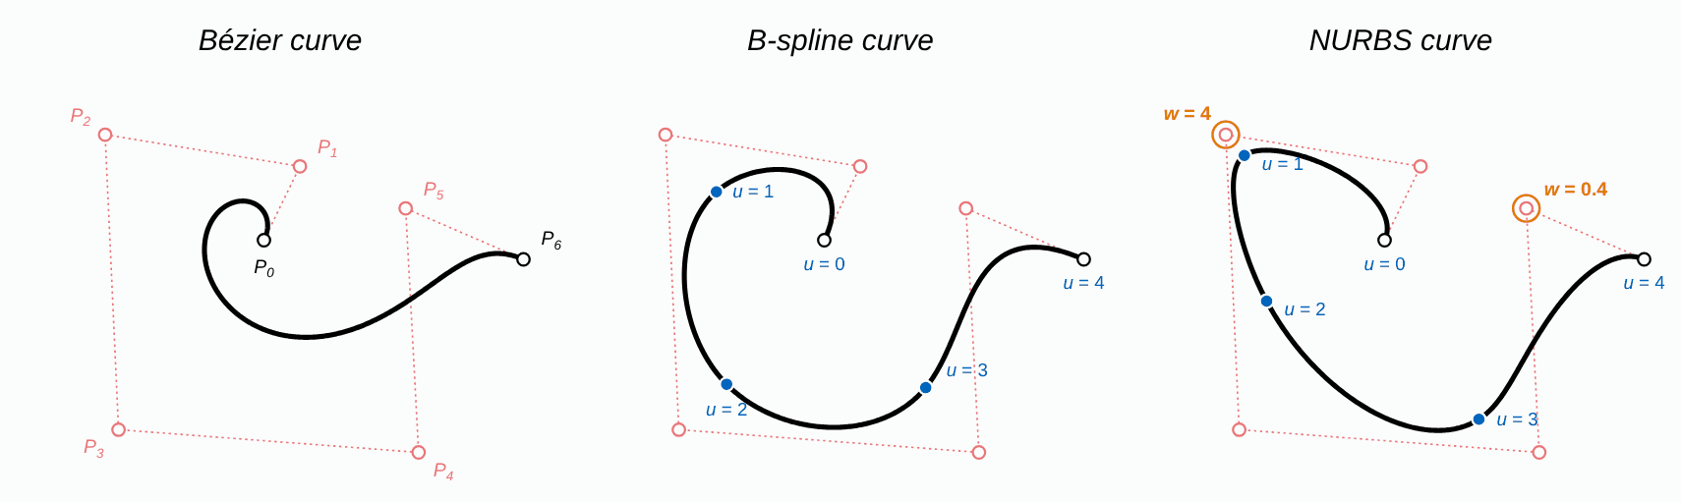
Freeform Curves
FREEFORM CURVES > SUMMARY
control points
control points
control points
- no local control
knots
knots
- Cannot create a circle
weights
+ Can define all shapes
Notes:
Purpose: to draw smooth geometries
Summary. Bézier: control points only, one piece, no local control. B-spline: adds knots, so the curve is made of low-degree pieces with local control, but it cannot make an exact circle. NURBS: adds weights, and can describe every standard and free-form curve.

